Slide 1
SYMMETRIC KEY DISTRIBUTION USING SYMMETRIC ENCRYPTION
Key distribution is the function that delivers a key to two parties who wish to exchange secure encrypted data. Some sort of mechanism or pro- tocol is needed to provide for the secure distribution of keys.
Key distribution often involves the use of master keys, which are infrequently used and are long lasting, and session keys, which are generated and distributed for temporary use between two parties.

Slide 2
SYMMETRIC KEY DISTRIBUTION USING SYMMETRIC ENCRYPTION
The strength of any cryptographic system rests with the key distribution technique, a term that refers to the means of delivering a key to two parties who wish to exchange data without allowing others to see the key. For two parties A and B, key distribution can be achieved in a number of ways, as follows:
1. A can select a key and physically deliver it to B.
2. A third party can select the key and physically deliver it to A and B.
3. If A and B have previously and recently used a key, one party can transmit the new key to the other, encrypted using the old key.
4. If A and B each has an encrypted connection to a third party C, C can deliver a key on the encrypted links to A and B.

Slide 3
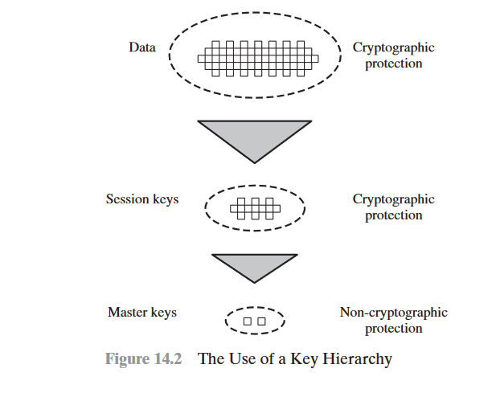

Slide 4
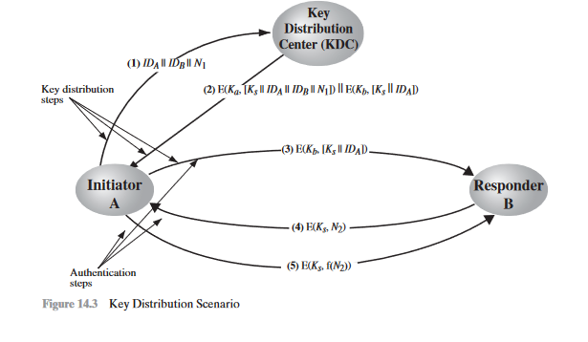
A Key Distribution Scenario
The key distribution concept can be deployed in a number of ways.

Slide 5
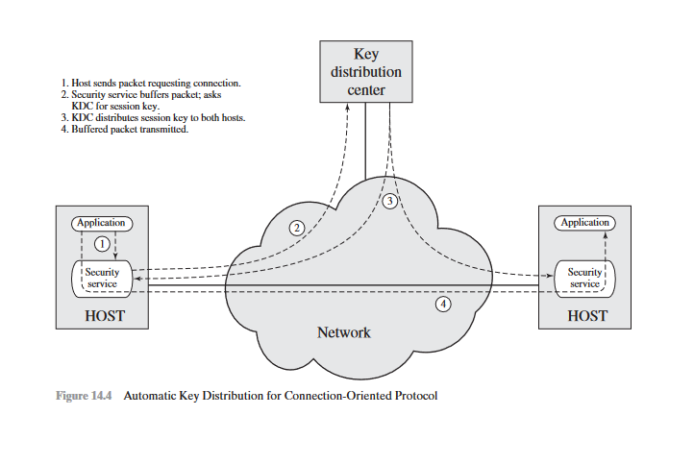

Slide 6
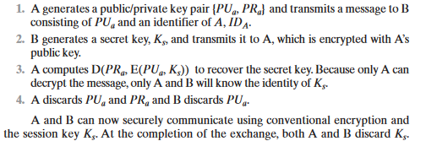
Symmetric Key Distribution using asymmetric encryption
One of the most important uses of a public-key cryptosystem is to encrypt secret keys for distribution. If A wishes to communicate with B, the following procedure is employed:

Slide 7
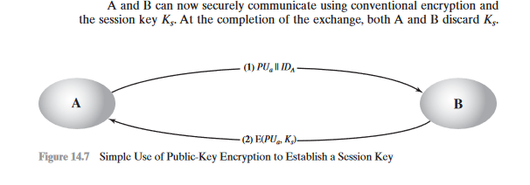

Slide 8
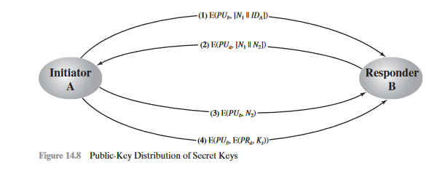
Secret Key Distribution with Confidentiality and Authentication

Slide 9
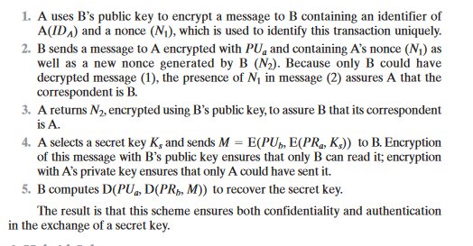

Slide 10
Distribution of public key
Several techniques have been proposed for the distribution of public keys. Virtually all these proposals can be grouped into the following general schemes:
• Public announcement
• Publicly available directory
• Public-key authority
• Public-key certificates

Slide 11
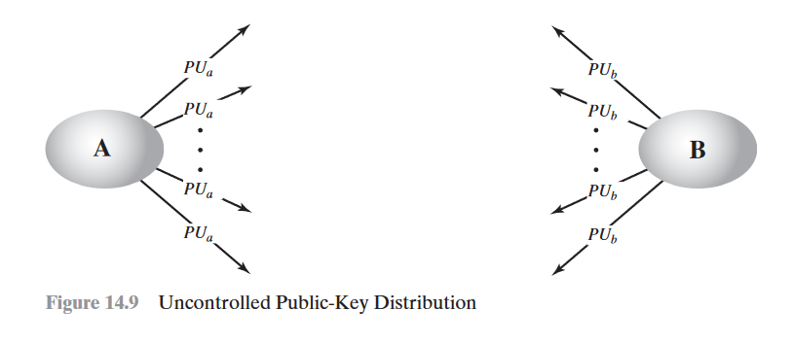
Public Announcement of Public Keys
the point of public-key encryption is that the public key is public. Thus, if there is some broadly accepted public-key algorithm, such as RSA, any participant can send his or her public key to any other participant or broadcast the key to the community at large .

Slide 12
Publicly Available Directory
A greater degree of security can be achieved by maintaining a publicly available dynamic directory of public keys
1.The authority maintains a directory with a {name, public key} entry for each participant.
2. Each participant registers a public key with the directory authority. Registration would have to be in person or by some form of secure authenticated communication.
3.A participant may replace the existing key with a new one at any time, either because of the desire to replace a public key that has already been used for a large amount of data

Slide 13
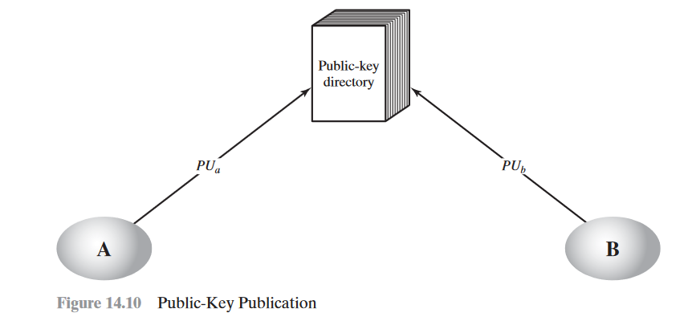
4.Participants could also access the directory electronically. For this purpose, secure, authenticated communication from the authority to the participant is mandatory.

Slide 14
Public-Key Authority
Stronger security for public-key distribution can be achieved by providing tighter control over the distribution of public keys from the directory.
1.A sends a timestamped message to the public-key authority containing a request for the current public key of B.
2.The authority responds with a message that is encrypted using the authority’s pri-vate key PR auth.

Slide 15
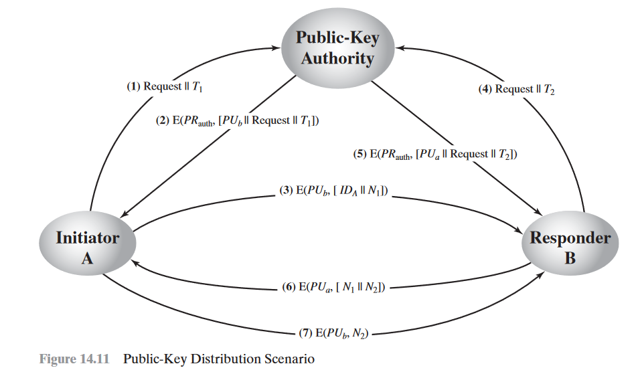

Slide 16
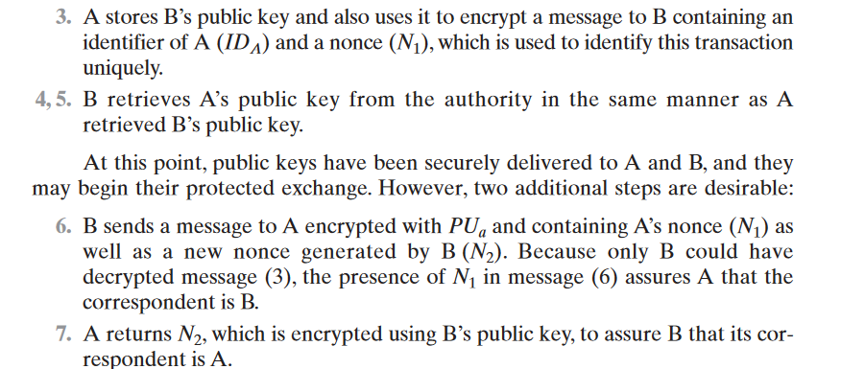

Slide 17
Public-Key Certificates
1. Any participant can read a certificate to determine the name and public key of the certificate’s owner.
2. Any participant can verify that the certificate originated from the certificate authority and is not counterfeit.
3. Only the certificate authority can create and update certificates.
4. Any participant can verify the currency of the certificate

Slide 18
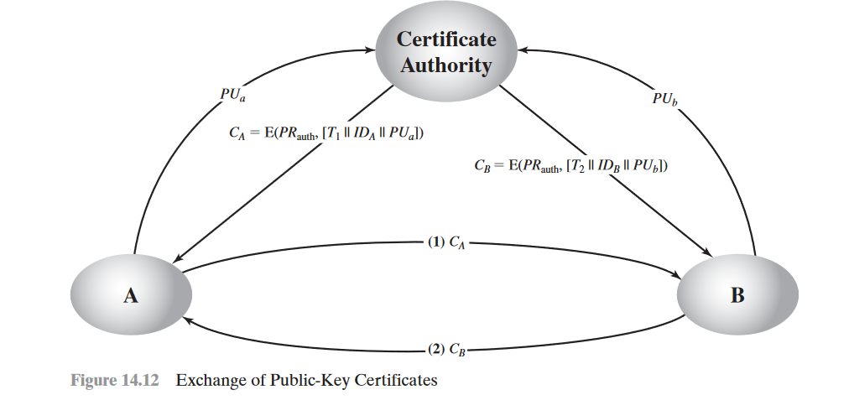

Slide 19
X.509 certificates
X.509 is part of the X.500 series of recommendations that define a directory service. The directory is, in effect, a server or distributed set of servers that maintains a database of information about users. The information includes a mapping from user name to network address, as well as other attributes and information about the users.
X.509 is an important standard because the certificate structure and authentication protocols defined in X.509 are used in a variety of contexts. For example, theX.509 certificate format is used in S/MIME , IP Security ,and SSL/TLS .

Slide 20
Certificates
The heart of the X.509 scheme is the public-key certificate associated with each user. These user certificates are assumed to be created by some trusted certifica- tion authority (CA) and placed in the directory by the CA or by the user.

Slide 21
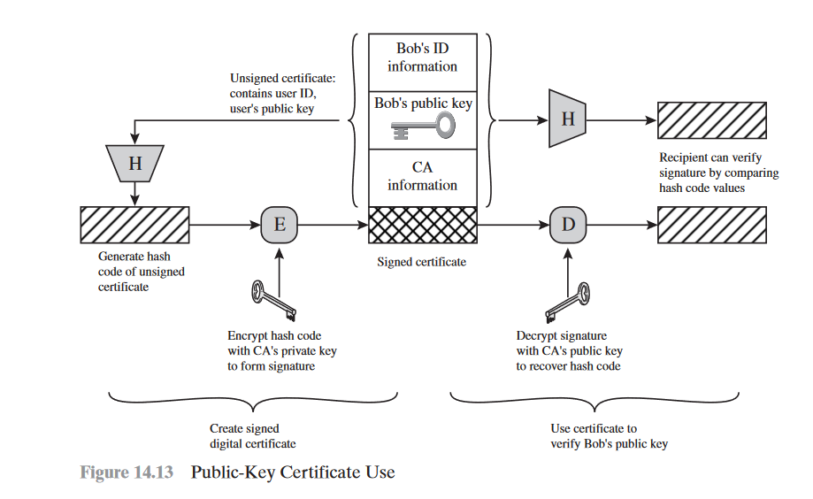

Slide 22
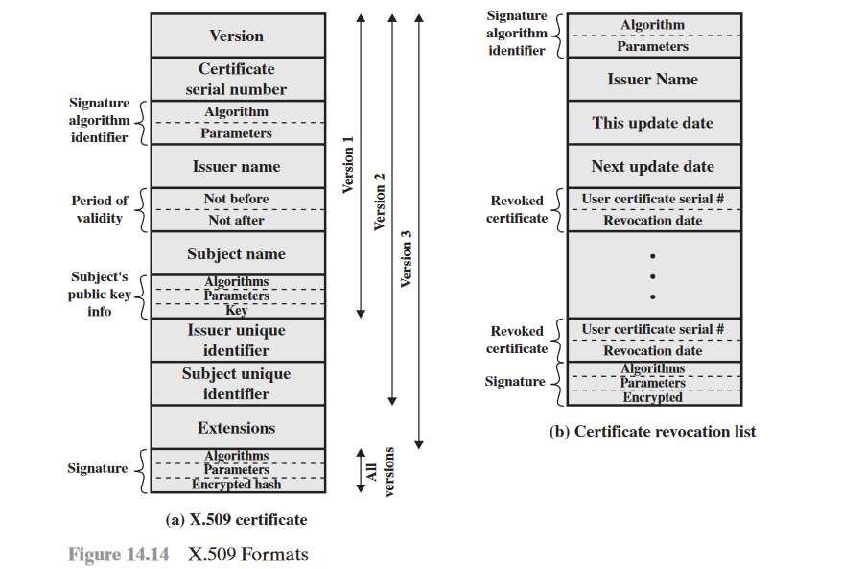

Slide 23
public-key infrastructure (PKI)
public-key infrastructure (PKI) as the set of hardware, software, people, policies, and procedures needed to create, manage, store, distribute, and revoke digital certificates based on asymmetric cryptography.
The principal objective for developing a PKI is to enable secure, convenient, and efficient acquisition of public keys.

Slide 24
End entity: A generic term used to denote end users, devices (e.g., servers, routers), or any other entity that can be identified in the subject field of a public key certificate.
Certification authority (CA): The issuer of certificates and (usually) certificate revocation lists (CRLs). It may also support a variety of administrative functions, although these are often delegated to one or more Registration Authorities.

Slide 25
Registration authority (RA): The RA is often associated with the end entity registration process but can assist in a number of other areas as well.
• CRL issuer: An optional component that a CA can delegate to publish CRLs.
• Repository: A generic term used to denote any method for storing certificates and CRLs so that they can be retrieved by end entities.

Slide 26
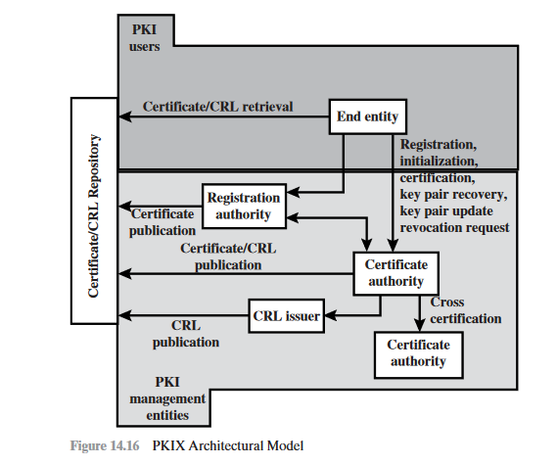

Slide 27
PKIX Management Functions
Registration:
Initialization:
Certification:
Key pair recovery
Key pair update:
Revocation request:
Cross certification

